Slide 1
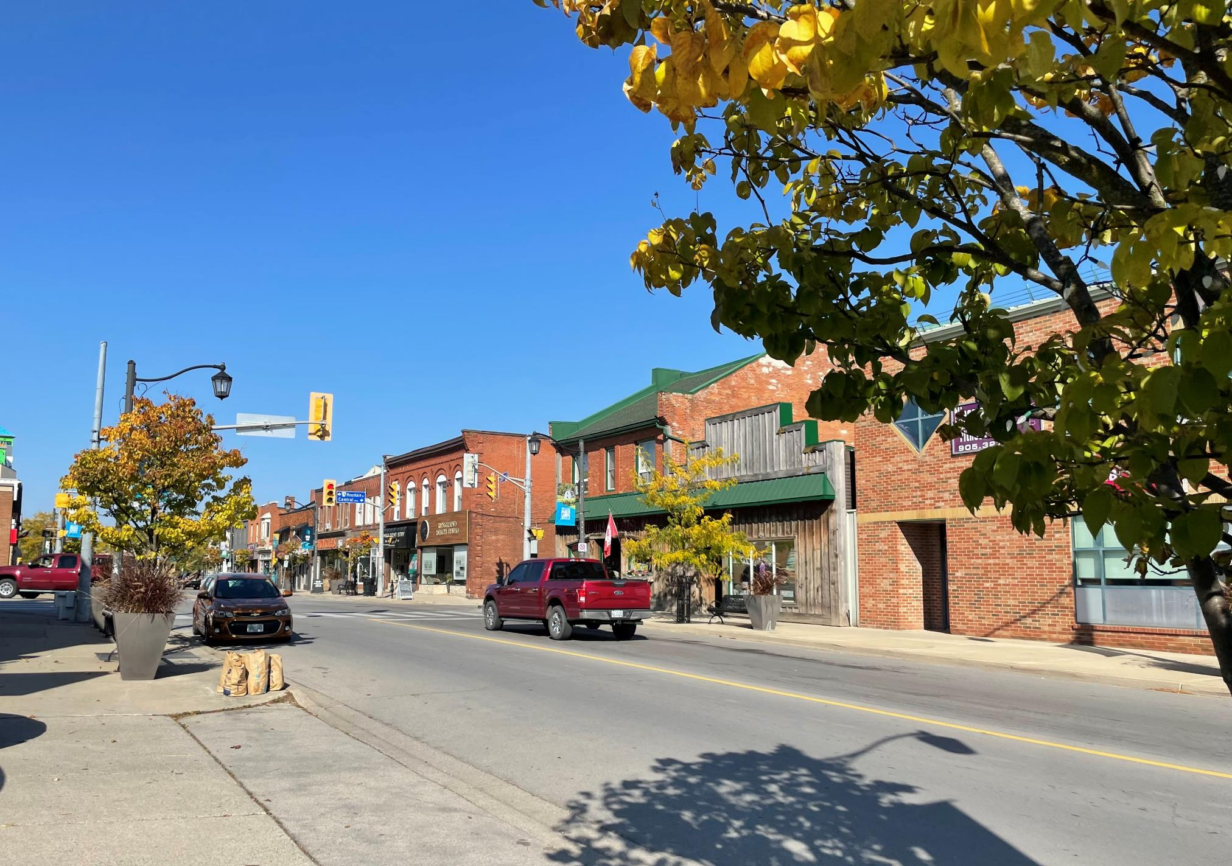

Town of Lincoln Heritage Conservation District (HCD) Study- Beamsville’s King Street Corridor
Municipal Heritage Committee
July 13, 2023

Slide 2










Meet our Project Team at AECOM
Erin Huck,
MA, MCP, MCIP, RPP, MPPI
Role: Public Engagement Lead and Policy Review
Don Hester, M.Arch, MCIP, RPP, MPPI, FCSLA, OALA, AALA, BCSCLA, SALA, MALA
Role: Urban Planning/ Landscape Advisor
Michael Magnan, M.Arch, AALA, BCSCLA, CSLA
Role: Urban Design Advisor
Tara Jenkins, MA, GPCertCHS, CAHP
Role: Project Manager
Ben Clark, BA
Role: GIS Lead
Alicia Evans, MSc, CPF
Role: Facilitator
Town of Lincoln
Monika Cocchiara
Manager of Planning & Development
Matt Bruder
Director of Planning & Development
Jake Harper, MA
Role: Heritage Researcher
Liam Smythe, B. URPl
Role: Cultural Heritage Specialist
Liam Ryan, MES
Role: Cultural Heritage Planner
Tracey McKenna, MA
Role: Engagement Support

Slide 3

Heritage Conservation District Designation - A Two Step Process
We Are Here!
Designating an HCD is a 2-step process:
The HCD Study
To determine if the HCD Study Area merits designation
2. The HCD Plan (also referred to as Implementation Phase)
HCD Plans provide policies and guidelines so municipalities have the tools to help appropriately manage change within a historic area.
Municipal by-law is passed to designate all properties within the HCD boundary under Part V of the Ontario Heritage Act.
Community input is key in the HCD process. Strong community input is required when deciding to use an HCD as a tool to conserve heritage.

Slide 4
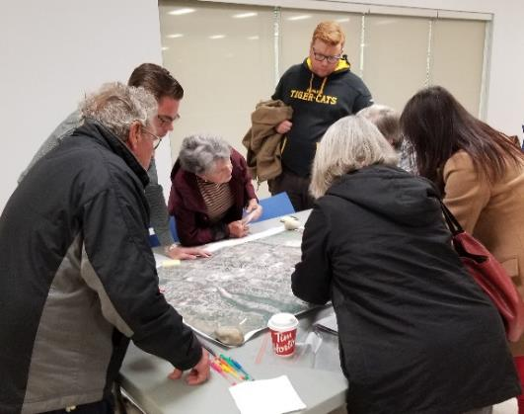
Community Engagement To Date
PIC #1 was held on November 2, 2022
Over 40 Beamsville participants attended PIC #1
AECOM presented a detailed account of the HCD Study process and key tasks, received input on the proposed boundary
Other community input included an online survey with 13 questions
Received 62 responses to the online survey
Online mapping tool with comment points
Received four comment points
Municipal Heritage Committee meeting held on July 14, 2022.
Council meeting held on August 2, 2022.
PIC #2 was held June 7, 2023
“small town feel”
“slow relaxed pace”
“small town atmosphere”

Slide 5
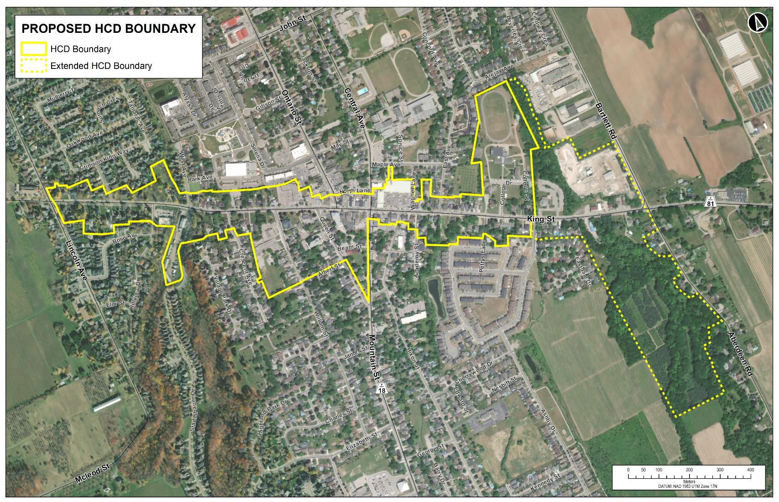


Slide 6
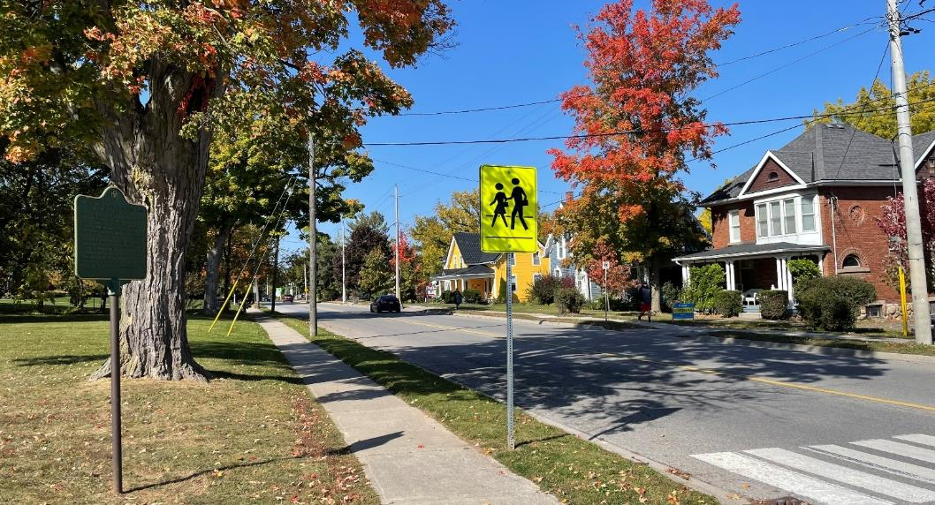
Character Analysis

Slide 7
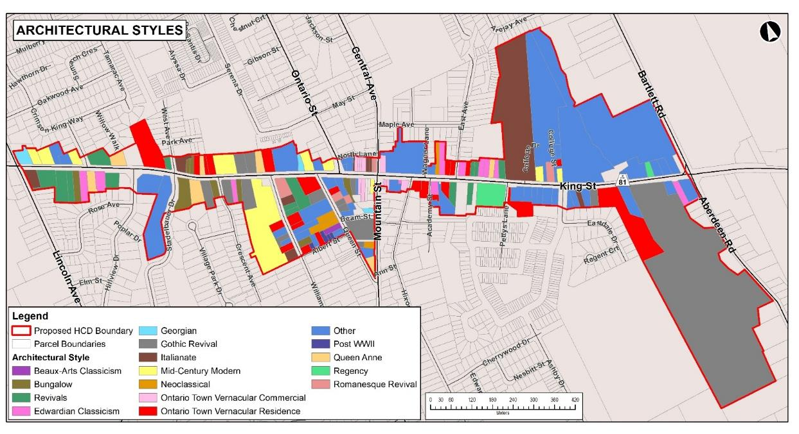
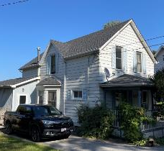
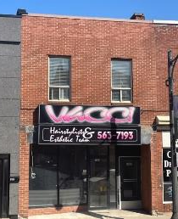
Architectural Styles
Analysis
The highest representation of a formal architectural style is Ontario Town Vernacular buildings (20% of buildings) most of which are built between 1870s-1920s
General high representation of 19th and 20th twentieth building styles

Slide 8

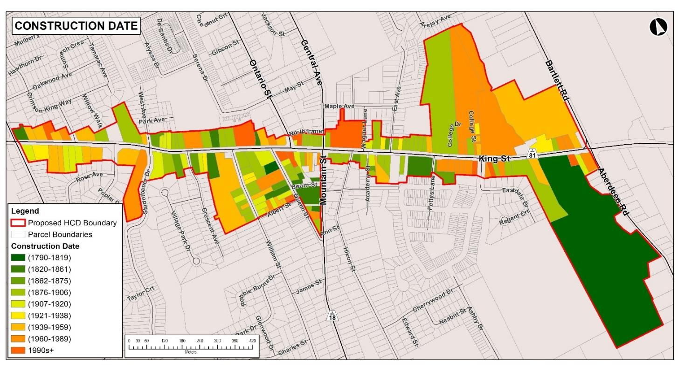
Periods of Construction
Key Results:
60.6% or 103 of the 170 buildings were built between 1790-1920
48.8% or 83 of the 170 buildings were built between 1876-1920

Slide 10
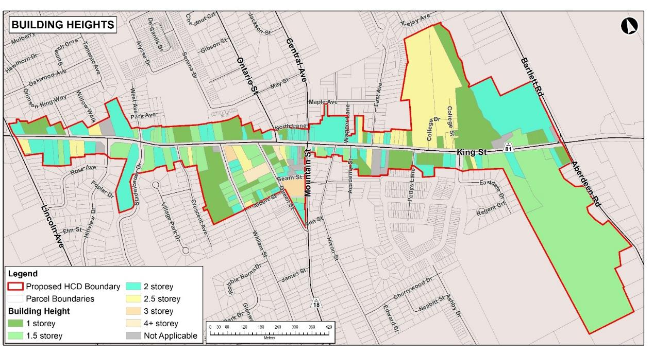
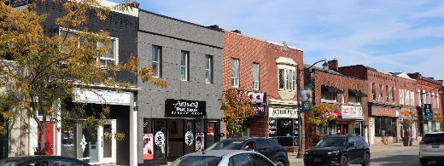
Distribution of Heights
Key Results
With exception of two medium rise residential buildings, all buildings within the Study Area are less than 3 storeys in height.
145 of the 170 properties with buildings, or 84.8% in the Study Area are two storeys or less.
Predominant uniform height of 2 storeys in the downtown commercial core to create a consistent streetwall profile.
Area History- Drafted
Property Inventory – Complete
Policy Review – In Progress
Character Analysis – In Progress

Slide 11
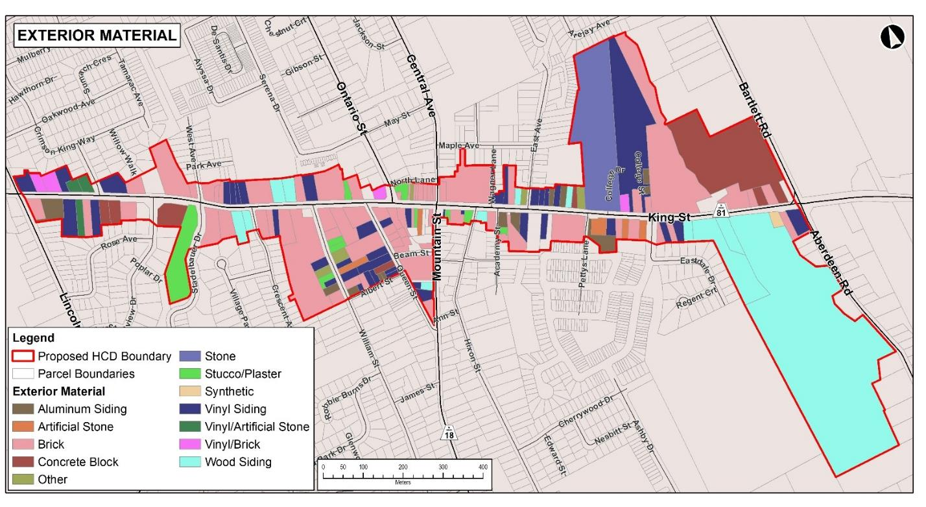
Building Materials
Key Results
67 or 56.7% of the buildings in the Study Area were constructed of brick.
Brick became the favoured construction material beginning in the 1890s
Several brick buildings with terra cotta details are associated with the Beamsville Pressed Brick Co.

Slide 12
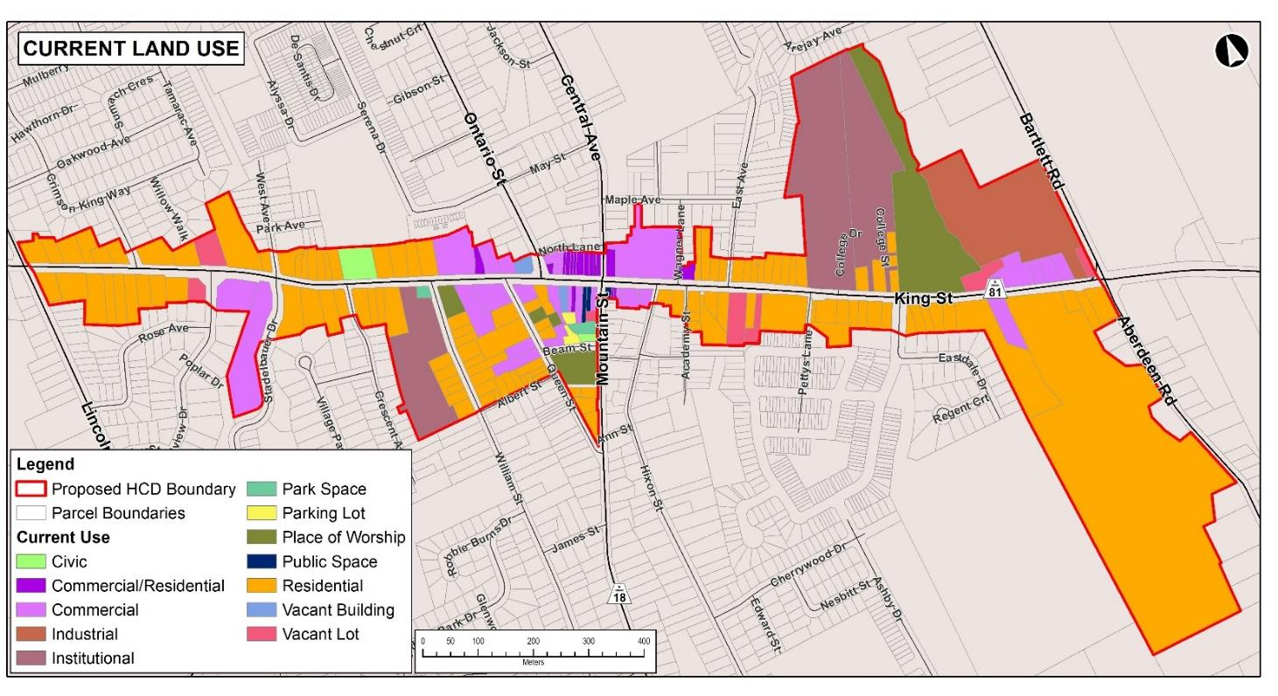
Current Land Use
Key Results
115 of the 183 (62.8%) of the properties are residential
Mixed-use area containing civic, institutional and commercial buildings are near or in the commercial core, associated with the 19th century settlement area.

Slide 13
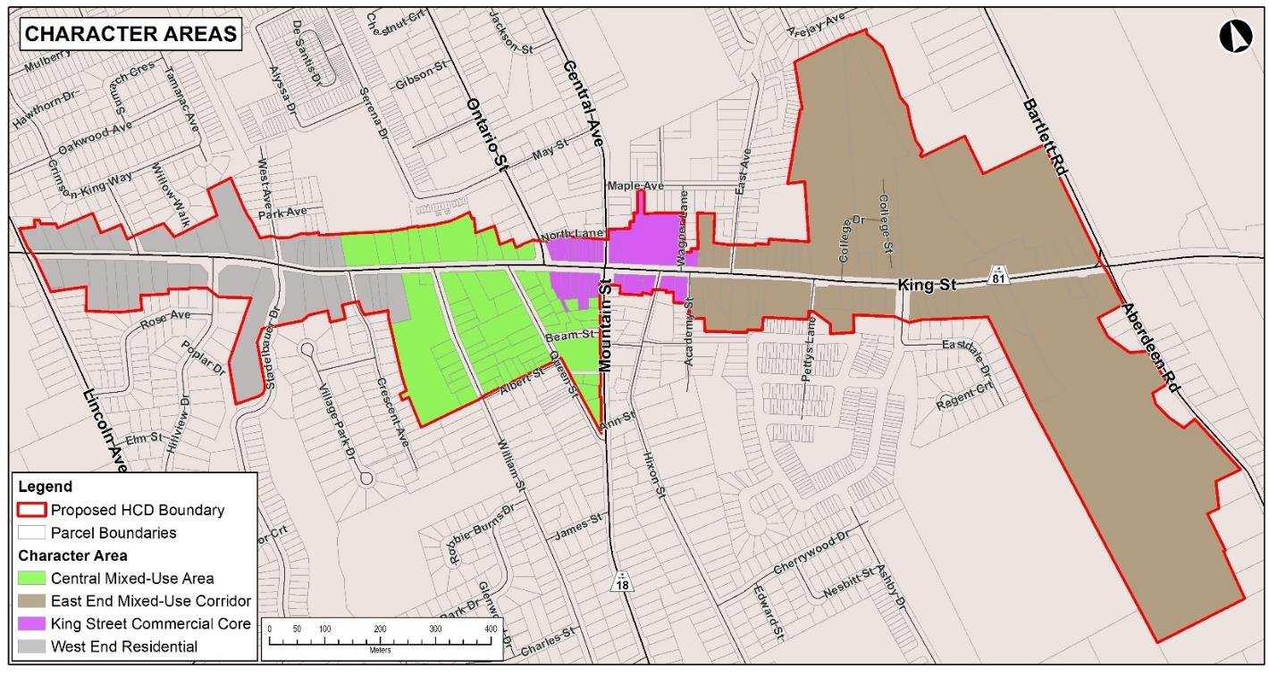
Landscape Analysis
Key Results:
Four character areas:
West End Residential (38 properties)
Central Mixed-Use Area (60 properties)
King Street Commercial Core (30 properties)
East End Mixed-Use Corridor (55 properties)

Slide 14
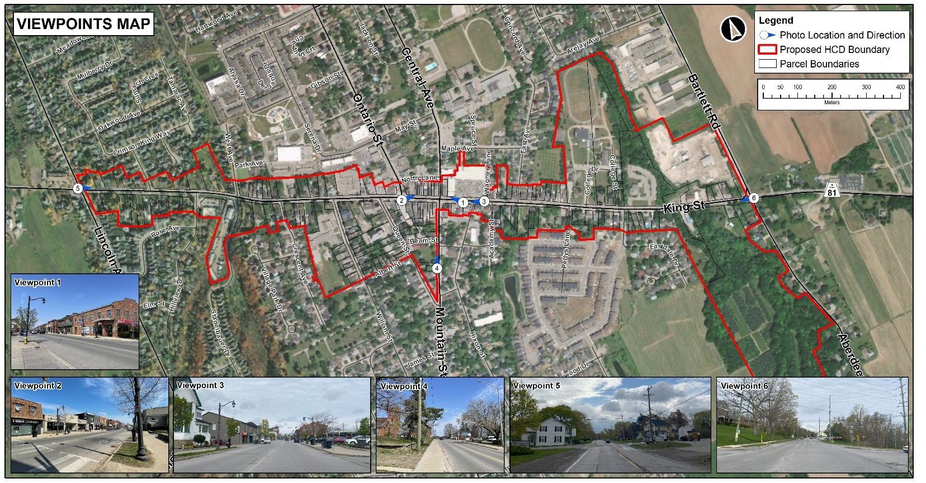

Slide 15

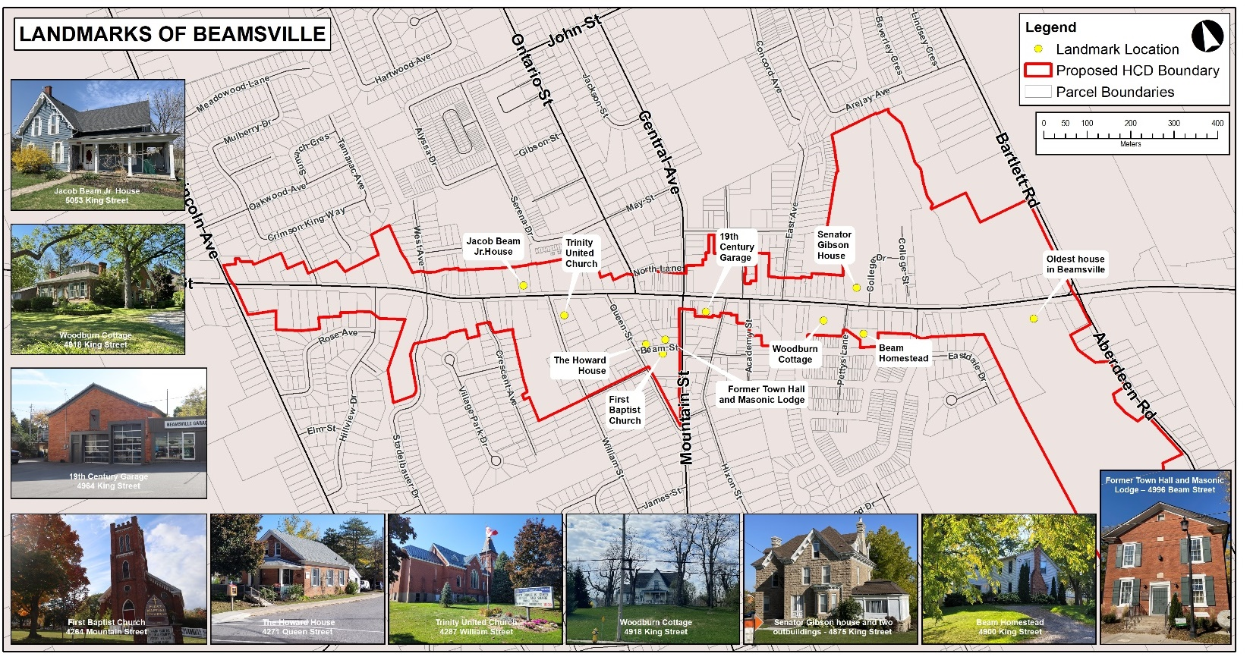

Slide 16
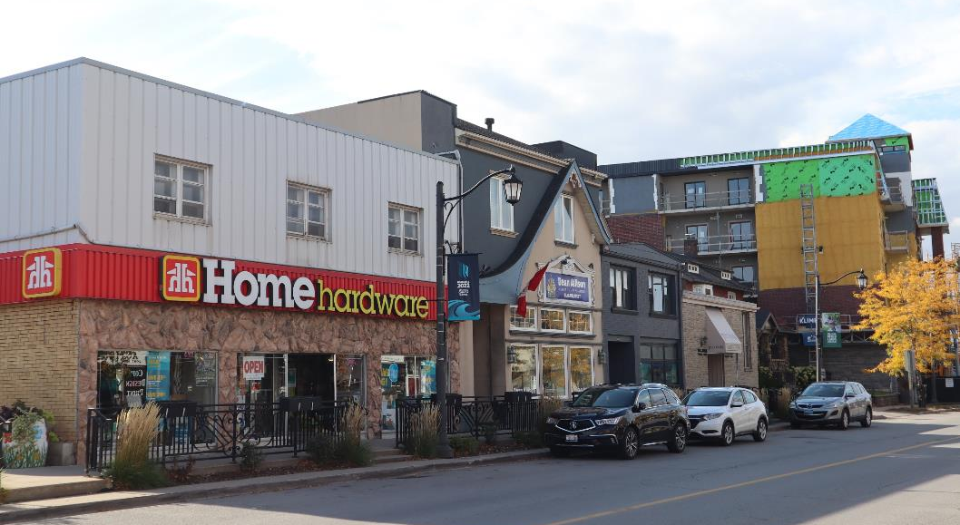
Heritage Evaluation

Slide 17
Bill 23, More Homes Built Faster Act, 2022
Schedule 6 of Bill 23 amends the Ontario Heritage Act (OHA).
When the More Homes Built Faster Act, 2022, came into force, so did Ontario Regulation 569/22 which included an amendment to section 41(1) of Part V of the OHA for HCDs providing newly developed criteria for evaluating a study area to see if it merits designation under the OHA.
Properties currently Listed on the Heritage Register in Town of Lincoln will require a Notice of Intention to Designate under Section 29 of the OHA, or they will be removed by January 1, 2025 and will not be permitted to be readded to the register for 5 years (and meet at least one criteria of the Ontario Regulation 9/06 to be eligible for listing).

Slide 18
Heritage Evaluation
Evaluation Sheet # |  | ##
Property Address |  | #####
Criteria | ✓ | Rationale
1. The property has design value or physical value because it is a rare, unique, representative or early example of a style, type, expression, material or construction method. | ✓ | This property is a representative example of a 2.5 storey Edwardian Classicism style brick house constructed c. 1909-1920.
2. The property has design value or physical value because it displays a high degree of craftsmanship or artistic merit. |  | Does not meet this criterion.
3. The property has design value or physical value because it demonstrates a high degree of technical or scientific achievement. |  | Does not meet this criterion.
4. The property has historical value or associative value because it has direct associations with a theme, event, belief, person, activity, organization or institution that is significant to a community. |  | Not determined to meet this criterion at this time.
5. The property has historical value or associative value because it yields, or has the potential to yield, information that contributes to an understanding of a community or culture. |  | Not determined to meet this criterion at this time.
6. The property has historical value or associative value because it demonstrates or reflects the work or ideas of an architect, artist, builder, designer or theorist who is significant to a community. |  | Not determined to meet this criterion at this time.
7. The property has contextual value because it is important in defining, maintaining or supporting the character of an area. | ✓ | Supports the heritage character of the East End Mixed-Use Corridor.
8. The property has contextual value because it is physically, functionally, visually or historically linked to its surroundings. | ✓ | Is contextually linked to its surroundings.
9. The property has contextual value because it is a landmark. |  | Does not meet this criterion.
Key Steps to assess heritage evaluation of the Study Area:
Complete individual property heritage evaluations (O. Reg. 9/06, example shown on this slide)
Enter property evaluation results into Microsoft Excel for percentage calculation
Complete a heritage evaluation table for the whole Study Area with statistics from the individual property evaluations (Apply the 25% threshold) (see next slide for Ontario Regulation 9/06 criteria)

Slide 19
Heritage Evaluation Results
1. At least 25 per cent of the properties within the municipality or defined area or areas satisfy two or more of the following:
i. The properties have design value or physical value because they are rare, unique, representative or early examples of a style, type, expression, material or construction method. | ✓ (56.8%, 104 of 183 properties)
ii. The properties have design value or physical value because they display a high degree of craftsmanship or artistic merit.
iii. The properties have design value or physical value because they demonstrate a high degree of technical or scientific achievement.
iv. The properties have historical value or associative value because they have a direct association with a theme, event, belief, person, activity, organization or institution that is significant to a community. | ✓ (27.9%, 51 of 183 properties)
v. The properties have historical value or associative value because they yield, or have the potential to yield, information that contributes to an understanding of a community or culture.
vi. The properties have historical value or associative value because they demonstrate or reflect the work or ideas of an architect, artist, builder, designer or theorist who is significant to a community.
vii. The properties have contextual value because they define, maintain or support the character of the district. | ✓ (60.6%, 111 of 183 properties)
viii. The properties have contextual value because they are physically, functionally, visually or historically linked to each other. | ✓ (60.1%, 110 of 183 properties)
ix. The properties have contextual value because they are defined by, planned around or are themselves a landmark. O. Reg. 569/22, s. 1.
Complete heritage evaluation of the Study Area using the O. Reg. 9/06 criteria for HCDs (shown on this slide)
Based on the evaluation of each criterion, the Study Area meets four of the nine criteria. The Study Area has design/physical value, historical associative value, contextual value.

Slide 20
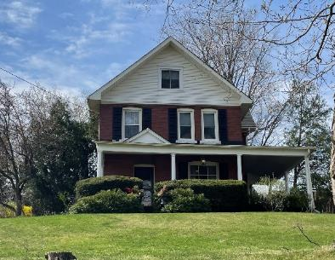
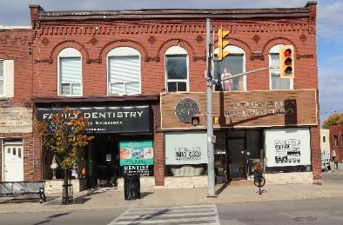
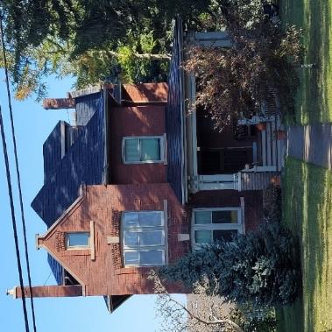
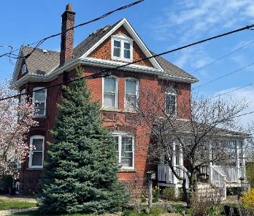
Preliminary Statement of Cultural Heritage Value Highlights
The HCD Study Area was determined to have design/physical value.
A representative example of a ‘Main Street’ corridor which comprises of King Street and historic offshoots down William, Queen, and Mountain streets. Collectively, the properties within the HCD Study Area reflect the 19th century settlement area. Individually, the area contains a high representation of buildings that are rare, unique, early, and representative examples of a variety of Ontario architectural styles.

Slide 21
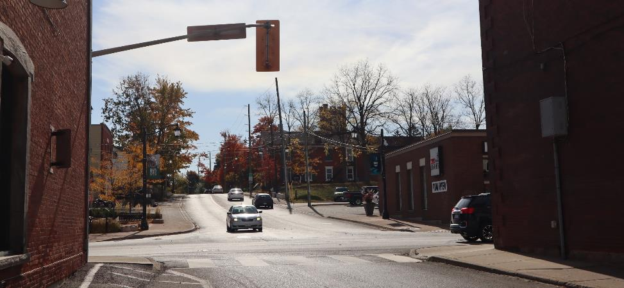
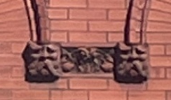
Preliminary Statement of Cultural Heritage Value Highlights
The HCD Study Area has contextual value:
The HCD Study Area has contextual value, as more than half of the buildings, along with landscape and streetscape elements, collectively define, maintain, and support the character of the proposed district. ;
Over half of the properties within the boundary have a relationship with and contribute to the character of Beamsville which as a whole, establish its unique heritage character
The HCD Study has historical associative value:
The HCD Study Area has historical associative value due to direct associations within significant individuals that are related to significant historical themes in Beamsville’s formative years such as industries related to agriculture and quarrying which are significant the community.
Red brick buildings with terra cotta associated with the Beamsville Pressed Brick Company (formally Tallman & Sons).

Slide 22
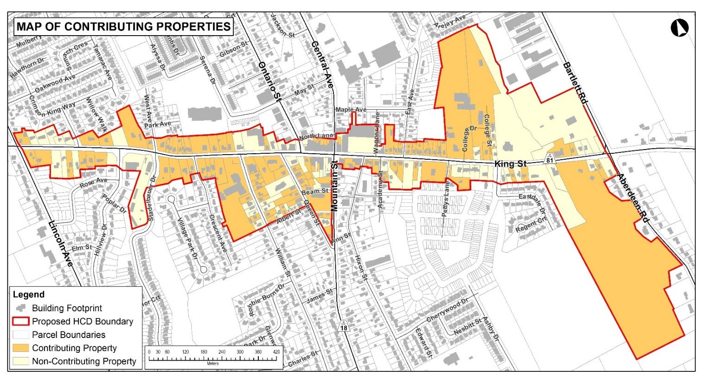
Contributing and Non-Contributing Properties
113 contributing and 70 non-contributing properties were identified with in the HCD Study Area.
If the HCD is designated, all the properties in the boundary are designated Part V of the Ontario Heritage Act.

Slide 23

Examples of HCD Policies
Pre-Application - Municipal Planner will decide whether a Heritage Permit is required or not
Type of Work |  | Contributing Properties | Non-Contributing Properties
Windows | Replacement with different material where the window is visible from the public realm (i.e. King Street) | Minor permit- requires staff approval | No heritage alteration permit
Porch | Removal of an original porch visible from the public realm (i.e., King Street) | Major permit- requires Council approval | No heritage alteration permit
Demolition | Removal of an existing house | Major permit- requires Council approval (when it is demonstrated there is no other viable option | No heritage alteration permit
New Construction | Construction of a new building such as a house on King Street | N/A | Major permit- requires Council approval

Slide 24
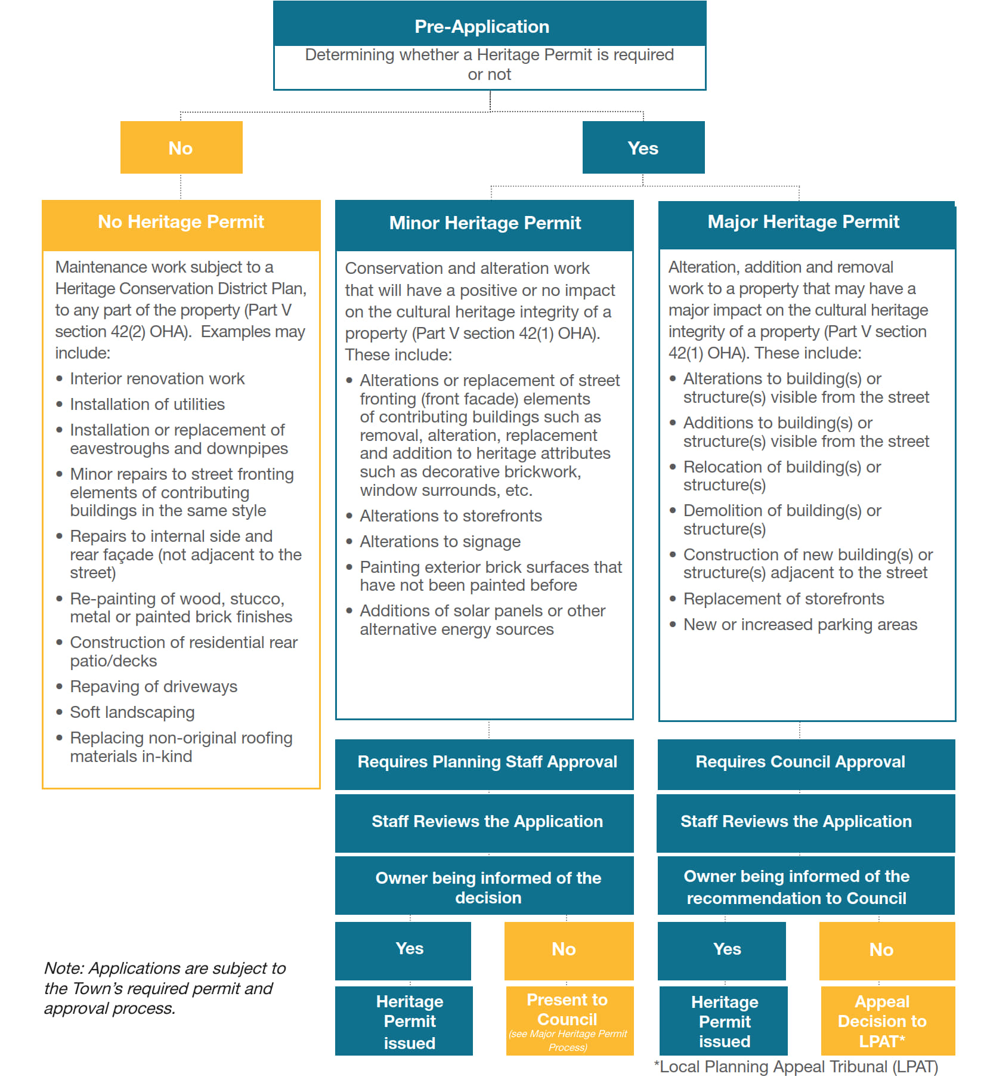
Example of a Heritage Permit Process; Downtown Beeton Heritage District Plan.
Town of New Tecumseth
https://www.newtecumseth.ca/en/business-and-development/resources/Proposed-Permit-Process---Beeton-HCD.pdf

Slide 25
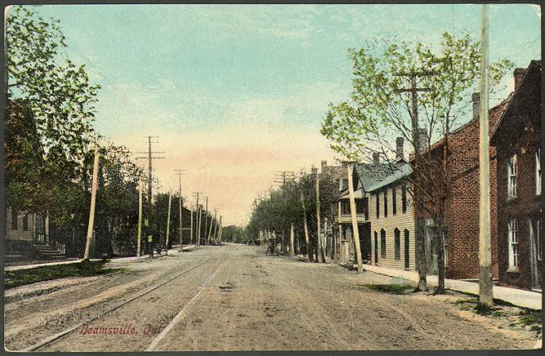
Recommendations
It is recommended that the Town of Lincoln proceed with a HCD Plan and Guidelines for the recommended HCD boundary.
Considerations for Part IV designations of listed properties outside HCD, as well as the former schoolhouse at 4240 Academy Street and Mount Osbourne Cemetery at 4230 William Street.

Slide 26
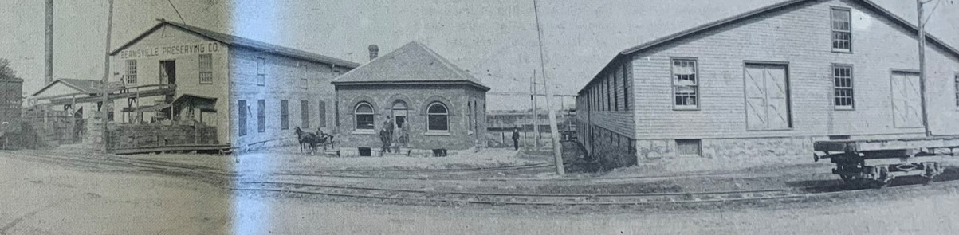
Next Steps
Present to the Committee of the Whole (end of summer 2023)
Present to Council (end of summer 2023)
Decision to proceed with the HCD Plan or Not
Finalize the HCD Study

